Slide 1
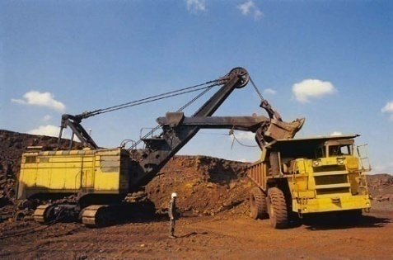
NATIONAL MINERAL POLICY 2008 (Non-fuel & Non-coal Minerals)
Nidhi Sharma
R Keerthi
Pooja Rani
T Beula Mathi
Nayantara Sasikumar
Aditya Saole
Amrit Lal Jangid
Abhay Singh
Vanjulavalli Sridhar
Devangi Swarnkar
87th FC
Dr. MCR HRD IAP, Hyderabad National Mineral Policy, 2008

Slide 2
Introduction
NMP ,1993
Anwarul Huda Committee, 2005
NMP 2008
Incentivizes domestic private sector and external sector for investment and technology flows
Building infrastructure
Increased transparency
‘Open sky policy’
87th FC
Dr. MCR HRD IAP, Hyderabad National Mineral Policy, 2008

Slide 3
Introduction
NMP 2008
Sustainable development framework: community engagement, benefit sharing,
R&D in minerals and human resource development
Mining tribunal for grievance redressal
International tie-ups: MoUs with countries like Australia, Canada, etc.
Auditing of mine closure plan
87th FC
Dr. MCR HRD IAP, Hyderabad National Mineral Policy, 2008

Slide 4
Stakeholders in National Mineral Policy
Government : Central & State
Private sector ( Domestic and Foreign)
Host Population
Government agencies (IBM, GSI , State Directorates of Mining and Geology)
Research and academic institutions
87th FC
Dr. MCR HRD IAP, Hyderabad National Mineral Policy, 2008

Slide 5
Elements Of The Policy
Mineral concession
Conservation of minerals
Sustainable utilization + economic growth
NMP 2008
Import substitution, value addition and export
Improvement in the life of associated people
Development of mineral- short, medium and long-term demand and supply
Development of mineral-mineral specific strategy
87th FC
Dr. MCR HRD IAP, Hyderabad National Mineral Policy, 2008

Slide 6
Public Good In The Policy
Generation of employment opportunities
Multiplier effect – tertiary sector spin off
New revenue source for states
87th FC
Dr. MCR HRD IAP, Hyderabad National Mineral Policy, 2008

Slide 7
Public Good In The Policy
Infrastructure development
Sustainable development model emphasized
Stakeholder interest model emphasized
87th FC
Dr. MCR HRD IAP, Hyderabad National Mineral Policy, 2008

Slide 8
Merits Of The Policy
Independent economic activity
Scientific prospecting and extensive R&D
Competitive edge to infrastructure, capital goods and basic industries.
Growth in employment and tertiary sectors
87th FC
Dr. MCR HRD IAP, Hyderabad National Mineral Policy, 2008

Slide 9
Demerits Of The Policy
Prioritises economic growth
Ambiguity regarding the relief and rehabilitation measures
Narrow in its scope
Lays emphasis on private sector
87th FC
Dr. MCR HRD IAP, Hyderabad National Mineral Policy, 2008

Slide 10
Demerits Of The Policy
No monitoring and follow-up action for implementation of environment management plan
Ambiguity in powers of local government
Districts where large-scale mining takes place are also some of the most backward districts
87th FC
Dr. MCR HRD IAP, Hyderabad National Mineral Policy, 2008

Slide 11
Implementation Issues
Shifting focus from conventional areas of managing the mineral concession to new areas
Regulation of mineral sector
Developing partnership with stakeholders
87th FC
Dr. MCR HRD IAP, Hyderabad National Mineral Policy, 2008

Slide 12
Implementation Issues
Efficient management of finite mining resources
Enhancing Research and development
Develop human resource in the sector
Ensuring the protection of interest of the host population
87th FC
Dr. MCR HRD IAP, Hyderabad National Mineral Policy, 2008

Slide 13
Implementation Issues
Strengthening of GSI, IBM
Arms length distance between those who mine and regulate
Financing of exploration projects
87th FC
Dr. MCR HRD IAP, Hyderabad National Mineral Policy, 2008

Slide 14
International Prespective
India scores lowest on parameters of interest of investors vis – a – vis Australia, Brazil, Chile, China and Indonesia (World Bank,2009)
Comprehensive plan including financial assurance for rehabilitation work before initiation of mining process (Ontario, Canada)
Calculation of royalties on actual profit of the company versus v/s that on pit mouth sales value
87th FC
Dr. MCR HRD IAP, Hyderabad National Mineral Policy, 2008

Slide 15
International Prespective
Linkage between mineral royalties and international market prices as in Peru
Current time frame between an application and PL higher compared to Canada
87th FC
Dr. MCR HRD IAP, Hyderabad National Mineral Policy, 2008

Slide 16
Alternative Policy Suggestions
Scrutiny of the prospective investors on Environmental and Social Impact Assessment
Cases of De Beers and Rio Tinto
Balanced Share of Mechanized and Labour-intensive models
For benefit of native population
Compulsory Environmental Regulations
Sustainable Development Framework
Deterrents for Non-compliance
87th FC
Dr. MCR HRD IAP, Hyderabad National Mineral Policy, 2008

Slide 17
Alternative Policy Suggestions
Increased Royalty for States
Currently 2-3 per cent of the Market Price
Substantial backing of Grand sounding claims
Like – “sustainable development”, “restoration of ecological balance” and “stakeholder interest”
Weightage to Panchayat Extension to Scheduled Areas (PESA) Act
In grant of mineral concessions for small deposits in Scheduled Areas
87th FC
Dr. MCR HRD IAP, Hyderabad National Mineral Policy, 2008

Slide 18
Conclusion
Management of minerals to be integrated into overall strategy of economic development
Stress on linkages with global demand and supply rather than just domestic industry
Resolution of conflicting laws at federal and state levels, thereby producing a clear picture to investors
Sustainable development model and stakeholder interest model to be
implemented
87th FC
Dr. MCR HRD IAP, Hyderabad National Mineral Policy, 2008

Slide 19
Conclusion
With the right kind of support, the mining sector has the potential to:-
Contribute to GDP in the range of 5-6% as compared to 1.5% contribution at present
Create 2 million to 2.5 million direct jobs by 2025, and an additional 11 million to 13 million jobs through indirect employment opportunities created in other sectors, thereby contributing 3 per cent to total employment
Make a substantial impact on the mineral-rich states—for instance, the contribution of mining to state GDP in Chhattisgarh could grow from the current 13 per cent to 20 per cent in 2025.
87th FC
Dr. MCR HRD IAP, Hyderabad National Mineral Policy, 2008

Slide 20
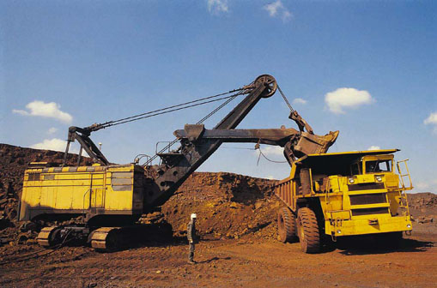
THANKS!
☺

